Slide 1
MNPS Coordinated School Health

Slide 3
Why should You rethink your drink?
Tennessee now has the highest rate of obesity in children ages 10-17 in the United States!*
1/5 of all weight gained by US population between 1977 and 2007 can be attributed to sugary drink consumption.
People who consume sugary drinks regularly have a 26% greater risk of developing type 2 diabetes.
Consumption of sugar-loaded drinks is now the largest category of caloric intake in children and teens, surpassing milk and pizza.
*State Health Performance Scorecard from The Commonwealth Fund http://datacenter.commonwealthfund.org/scorecard/state/44/tennessee/

Slide 4
Sugary Drinks and youth
Children and youth in the US average 224 calories per day from sugary beverages.
Beverages count for almost half (47%) of all added sugars consumed by US population.
One study found that for each additional 12-ounce soda youth consumed each day, the odds of becoming obese increased by 60%.

Slide 5
BMI Data

Slide 6
Why are sugary drinks bad for you?
Weight gain (extra sugar is stored as fat)
Studies in children and adults have found that reducing sugary drink consumption can lead to better weight control among those who are initially overweight.
Empty extra calories (no nutritional benefit)
42 minutes of walking to burn off the extra calories in just one 16oz bottle of coke
Causes cavities
Gives you brief energy, but then causes “sugar crash” and makes you tired, grouchy and unfocused.
Can increase risk of diabetes, heart attack, stroke and depression.

Slide 7
Why drink water?
Protects your body organs and tissues
Carries nutrients and oxygen to all the cells in your body
Helps you fight off illness
Helps you digest your food and get rid of waste
Regulates your body temperature
Hydrates your skin and hair
Zero calories and zero sugar!

Slide 8
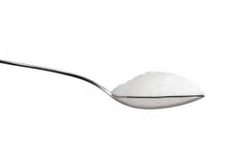
American Heart Association Guidelines
Youth should have no more than
6 teaspoons or 24 grams
of ADDED SUGAR per day.
1 can of coke has
10 teaspoons or 40 grams
of added sugar
1 Teaspoon of sugar = 4 grams of sugar
Notes:
Mention added sugar is any sugar or syrup added to foods or drinks while being processed or prepared, or added at the table
Optional: Bring in a visual of sugar in a glass and scoop out the teaspoons for them to see of each drink compared to their daily recommendation.

Slide 9
What is added sugar?
ANY sugar or syrup added to foods or drinks while being processed or prepared, or added at the table.
Read the ingredient label on processed food to identify added sugar:
All sugars and syrups (organic cane sugar, brown sugar, corn syrup, etc.)
Words ending in “ose” (fructose, high-fructose corn syrup, lactose, sucrose, glucose)
Honey, molasses, nectars, cane juice, fruit juice concentrate

Slide 10
Natural vs Artificial sweeteners
Your body metabolizes all added sugars the same way! There are minor differences between sweeteners
Natural sweeteners (honey, agave nectar, maple syrup) may be less processed but do not contain any more nutritional value unless you consumed large quantities
Artificial sweeteners (aspartame, saccharin, sucralose) are more processed and more potent (sucralose is 600 times sweeter than sugar)
Overstimulation of sugar receptors from frequent use of artificial sugars may limit tolerance for more complex tastes

Slide 11
Juice VS Whole fruitS/VegetablES
Juicing removes the fiber you need for healthy digestion and leaves you with sugar, water, some antioxidants, vitamins, and minerals.
Removing the fiber can lead to a spike in blood sugar which increases appetite and leaves you feeling hungry.
Green Machine Naked 100% Juice Smoothie – 270 Calories
53 grams of sugar = 13 teaspoons of sugar
0 grams of Dietary Fiber
100% juice contains some vitamins/minerals making it a healthier a choice than soda, but whole fruits and vegetables are best.

Slide 12
What about diet drinks?
Sugar substitutes have been shown to have the same effect on your body as sugar
When sugar substitutes enter the mouth, they activate sweet taste receptors on our tongue and trick the body into thinking it is about to consume sugar
The body then releases hormones to digest that sugar, but the sugar never arrives and this can cause your body to crave more sweet foods and drinks
Some studies have shown that long-term exposure to artificial sweeteners alters how the body metabolizes real sugar
Studies have found that over the course of about a decade, diet soda drinkers had a 70% greater increase in waist circumference compared with non-drinkers and drinking one diet soda a day was associated with a 36% increased risk of metabolic syndrome and diabetes

Slide 13
What’s in your Drink?

Slide 14
Water (12oz) 0 grams / 0 teaspoons of sugar

Slide 15
Powerade (12oz) 20 grams / 5 teaspoons of sugar

Slide 16
Starbucks Tall Iced Caffe Mocha 24 grams / 6 teaspoons of sugar

Slide 17
Sweet Tea (12oz) 29 grams / 7 teaspoons of sugar

Slide 18
Simply Orange 100% Orange Juice (12oz) 31 Grams / 8 teaspoons of sugar
*100% orange juice has no added sugar and does contain vitamins and minerals. However, it still contains a high amount of sugar to be consuming in one drink. A better option is to eat an orange which contains all the same vitamins and minerals but has fiber and less sugar.

Slide 19
Red Bull (12oz) 38 grams / 9 teaspoons of sugar

Slide 20
Coca Cola (120z) 40 grams / 10 teaspoons of sugar

Slide 21
Root Beer (12oz) 45 grams / 11 teaspoons of sugar

Slide 22
McDonalds small caramel frappe 55 grams / 13.75 teaspoons of sugar

Slide 23
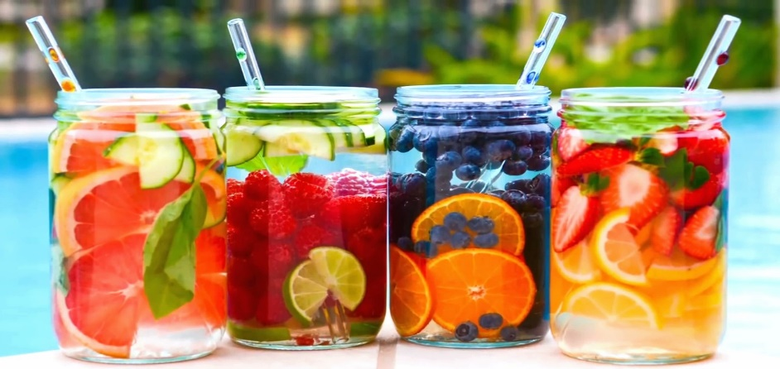
How can you drink more water?
Bring a water bottle to school everyday!
Drink a glass of water with every meal
Refill your water bottle at the hydration stations during your breaks
Drink water after PE class, exercising, and playing sports
Flavor it up! Add fresh lemon, lime, mint, etc. to your water

